Slide 1
Improvement Science
Improvement Science is a set of practices used to make meaningful and measurable improvements in things that matter.
It differs from research in that it’s goal is improvement rather than the creation of new knowledge.
We have all experienced an issue with purchasing an item with missing pieces, or a meal that didn’t come as ordered, or took forever to arrive while orders placed after yours were being served. This is a phenomenon of delays, defects, and deviation.
Improvement science uses performance data to pinpoint and eliminate delays, defects and deviation—the three silent killers of productivity and profitability.
One of my favorite aspects of improvement science is that the problem is rarely the people but the process. Fix the process and the people succeed.

Slide 2
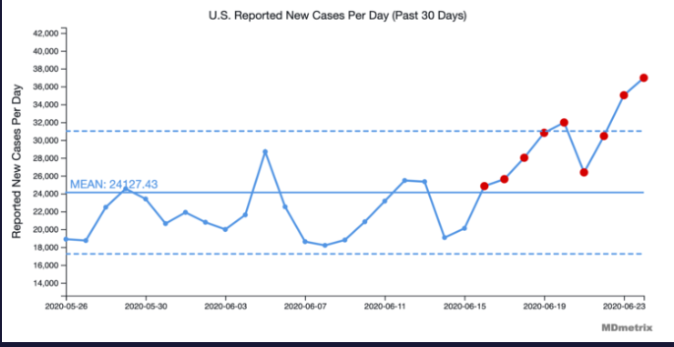
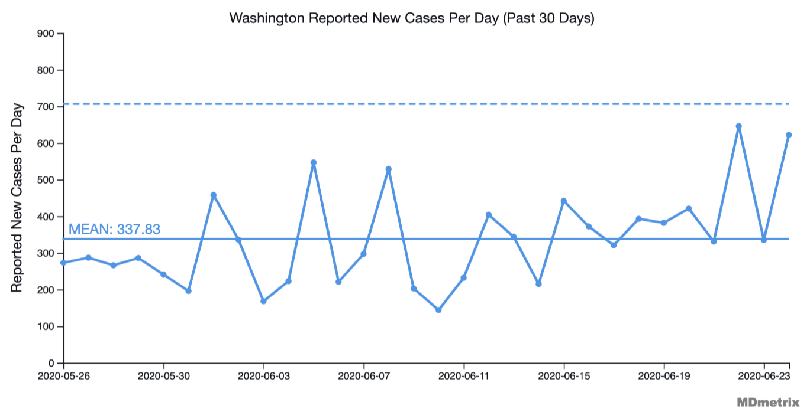
Nationally we have seen a statistically significant shift in positive cases.
Washington State is trending upward as well
https://www.mdmetrix.com/covid-19-projections

Slide 4
Improvement resources
How do I understand a control chart?
https://www.qimacros.com/control-chart/
How do I create control charts?
https://www.qimacros.com/
What books should I read?
The Health Care Data Guide: Learning from Data for Improvement
The Improvement Guide: A Practical Approach to Enhancing Organizational Performance

