Slide 1
NAEMSP Town Hall: Improvement Science Overview
Remle Crowe, PhD, NREMT
@rpcrowe

Slide 2
THE ESO MISSION
Make a Difference
Improve Community Health and Safety Through the Power of Data

Slide 3
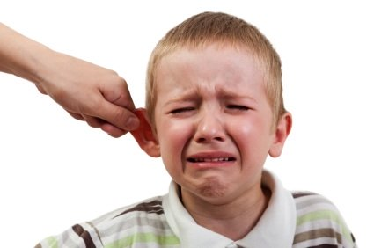
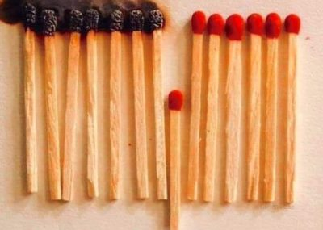
@NAEMSP
@rpcrowe
Improvement Science Overview
Compliance
Improvement

Slide 4
IHI
Model For
Improvement
@NAEMSP
@rpcrowe
Associates for Performance Improvement
Austin, TX
www.ihi.org
Notes:
RC to start

Slide 5
Measures: Operational Definitions
@NAEMSP
@rpcrowe
NOT GOOD ENOUGH

Slide 6
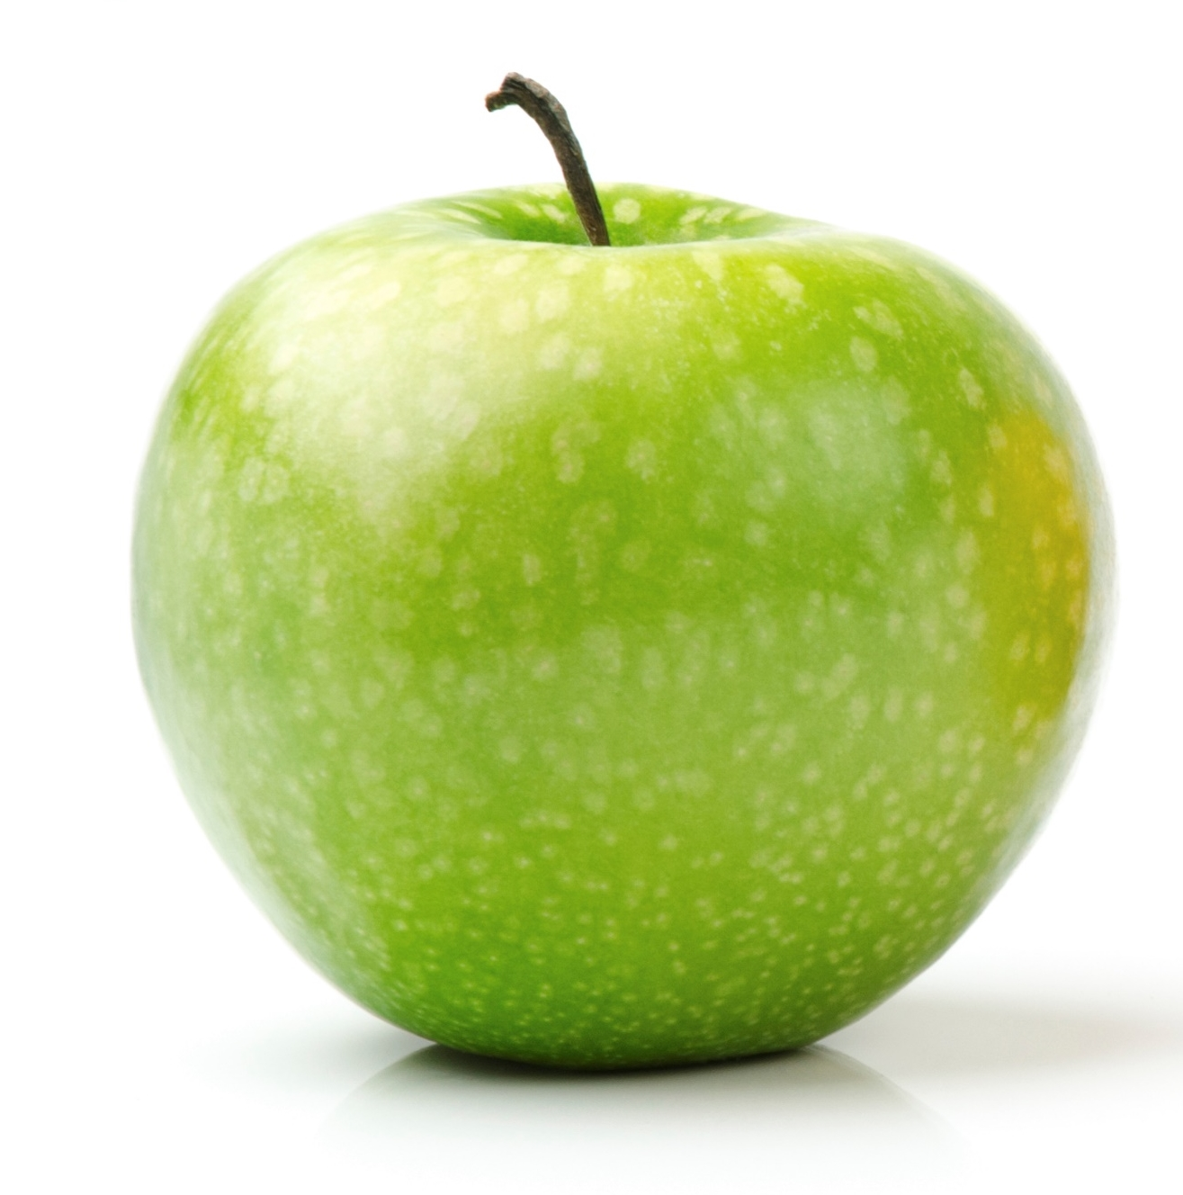
Measures: Operational Definitions
@NAEMSP
@rpcrowe

Slide 7
@NAEMSP
@rpcrowe
Given Two Different Numbers…
46
52

Slide 8
@NAEMSP
@rpcrowe
A Word of Caution
Resuscitation ROSC Rate

Slide 9
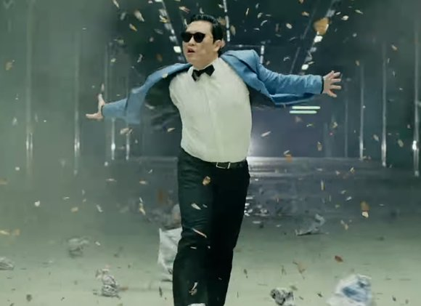
@NAEMSP
@rpcrowe
Celebration

Slide 10
@NAEMSP
@rpcrowe
Resuscitation ROSC Rate

Slide 11
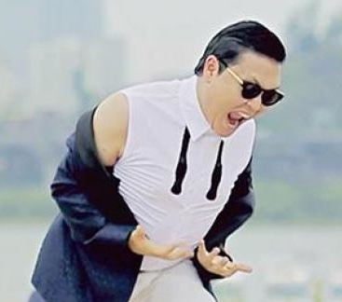
@NAEMSP
@rpcrowe
Despair

Slide 12
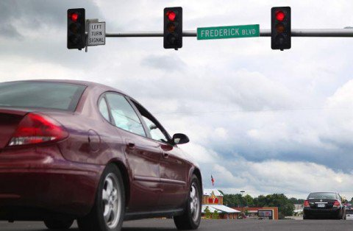
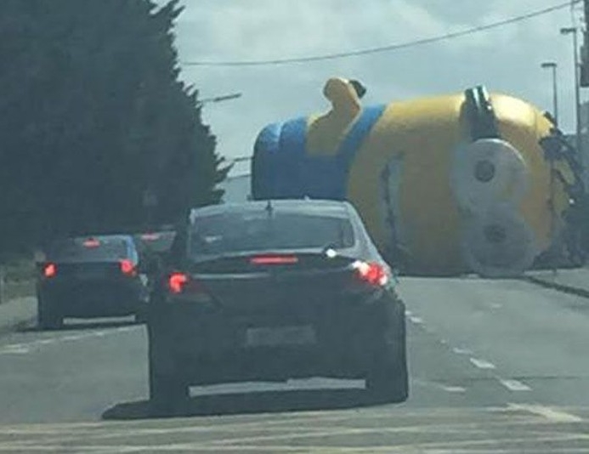
@NAEMSP
@rpcrowe
Morning Commute to Work
Common Cause Variation
Special Cause Variation

Slide 13
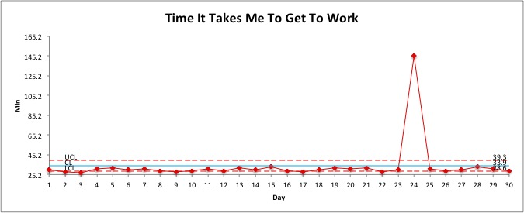
@NAEMSP
@rpcrowe
Control Charts

Slide 14
SMALL FAST Tests of Change
@NAEMSP
@rpcrowe
Adopt,
Adapt,
Abandon
Adopt,
Adapt,
Abandon
Plan
Do
Study
Act
Adopt,
Adapt,
Abandon
Do
Study
Act
Plan
Changes
that result in improvement
Plan
Do
Study
Act
Implementation
Hunches, theories, and ideas

Slide 15
Summary
@NAEMSP
@rpcrowe
Model for Improvement
Operational Definitions
Data Over Time
Types of Variation
Small Fast Tests of Change (Rapid Learning)

