Slide 1
NAEMSP Town Hall: Quality in COVID
Data vis, learning, and improvement
St. Charles County Ambulance District

Slide 2
Helpful to know where to spend most time training on PPE Donning and Doffing

Slide 3
Not Super Helpful

Slide 4
But its big brother was:
Useful for PPE usage predictions

Slide 5
Again:
Not Super Helpful

Slide 6
But its big brother was:
Useful for predicting provider exposure risk over time

Slide 7
On its own, not usually very helpful.
During COVID .. It showed intervention compliance during changing recommendations

Slide 8
Mapping our COVID+ chief complaints let us know that CARD36 inclusions were not as specific as we needed.

Slide 10
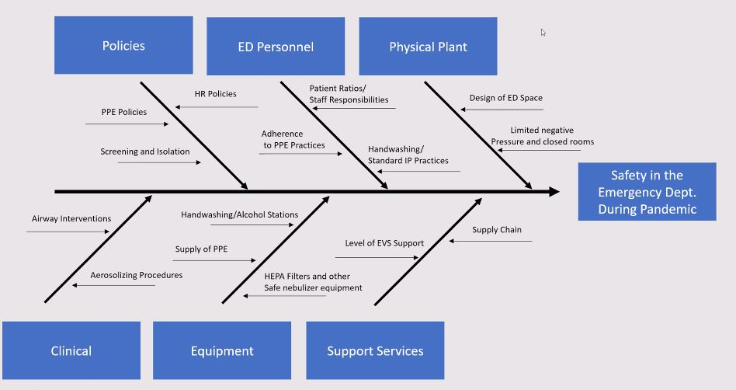
Quality is a Team Sport:
Fishbone from
Dr. Redlener

Slide 11
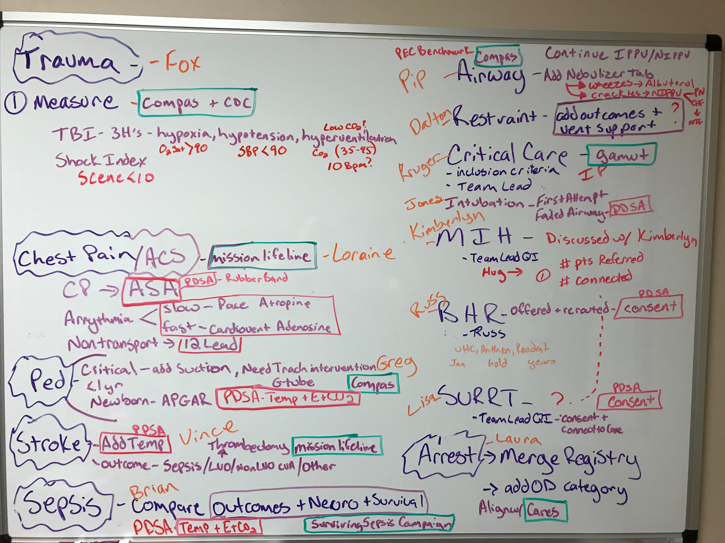
What my QI space actually looks like
Lots of messy notes and dry erase board…. And a reminder why its important

